Slide 1
R-GCNs With Box Embeddings
Ruud van Bakel, Bachelor Student AI
Vrije Universiteit Amsterdam

Slide 2
Research Question
To what extent can box embeddings improve graph embeddings for the structured query answering task.

Slide 3
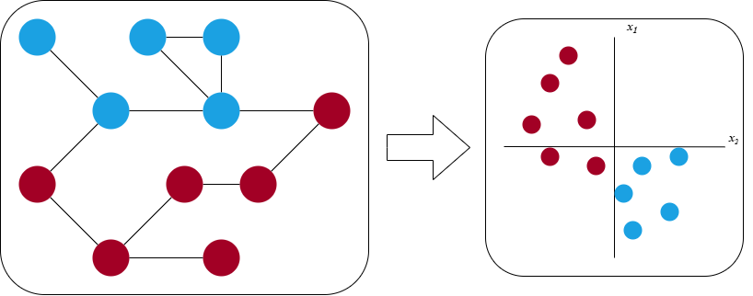
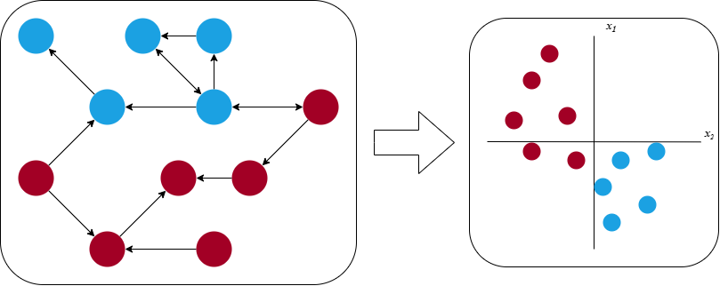
GCNs

Slide 4
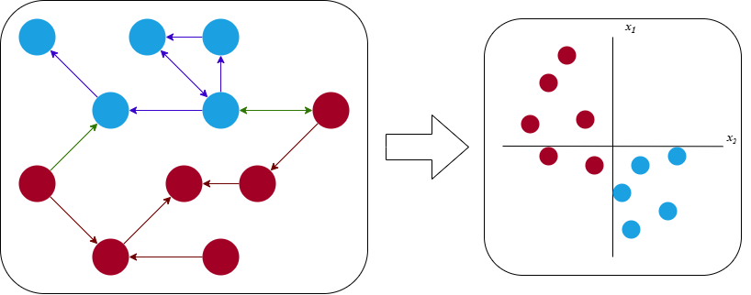
R-GCNs
Schlichtkrull, M., Kipf, T. N., Bloem, P., van den Berg, R.,Titov, I., and Welling, M. (2017). Modeling relational data with graph convolutional networks

Slide 5
Different Embedding Tasks
Link prediction
Entity Classification
Structured Query Answering

Slide 6
Structured Query
1
[1] Daza, D. and Cochez, M. (2020). Message passing query embedding. In ICML Workshop - Graph Representation Learning and Beyond

Slide 7
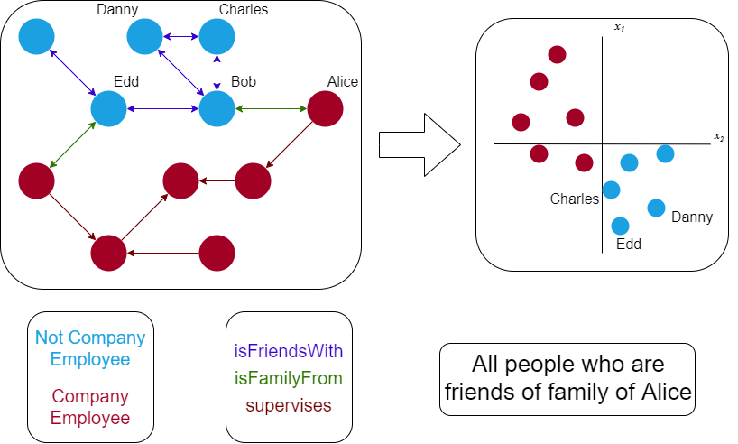
Structured Query Answering

Slide 8
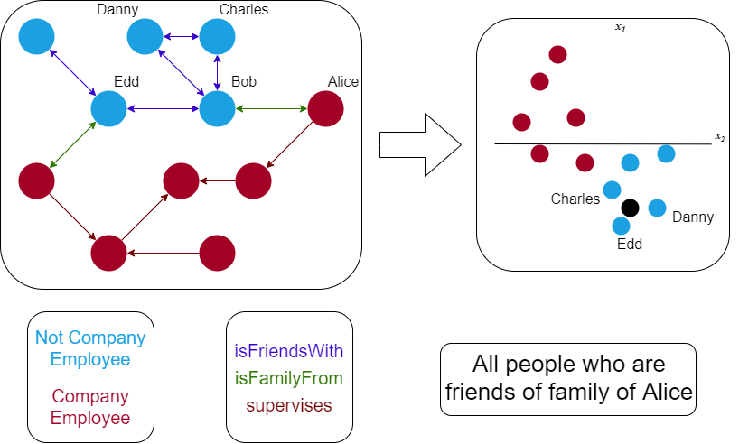
Traditional Structured Query Answering

Slide 9
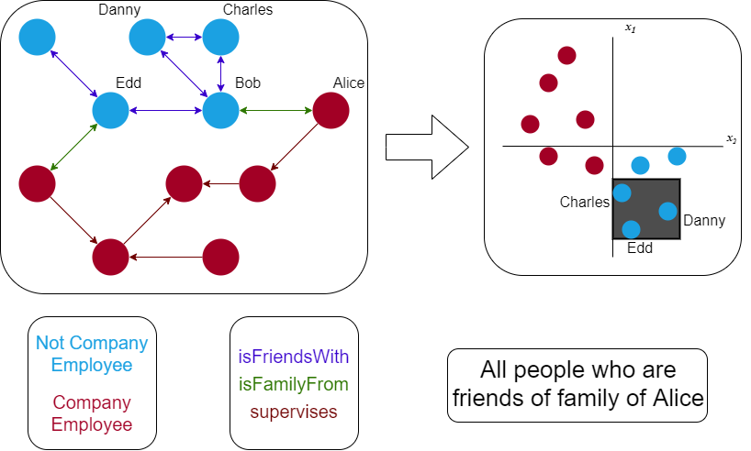
Box Structured Query Answering

Slide 10
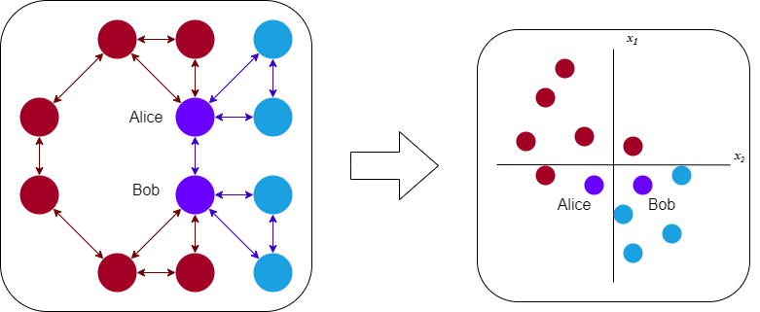
Embedded Close To Each Other?

Slide 11
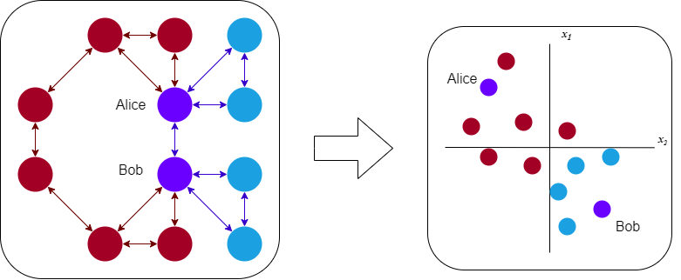
Embedded Far From Each Other?

Slide 12
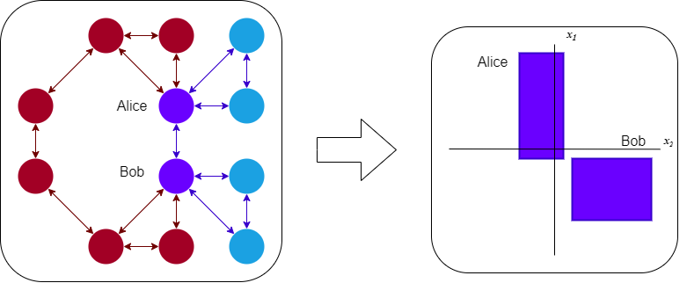
Box Embedding

Slide 13
How is this achieved?
Entity embeddings
R-GCN
MPQE model
Special loss function
1
2
[1] Schlichtkrull, M., Kipf, T. N., Bloem, P., van den Berg, R.,Titov, I., and Welling, M. (2017). Modeling relational data with graph convolutional networks
[2] Daza, D. and Cochez, M. (2020). Message passing query embedding. In ICML Workshop - Graph Representation Learning and Beyond

Slide 14
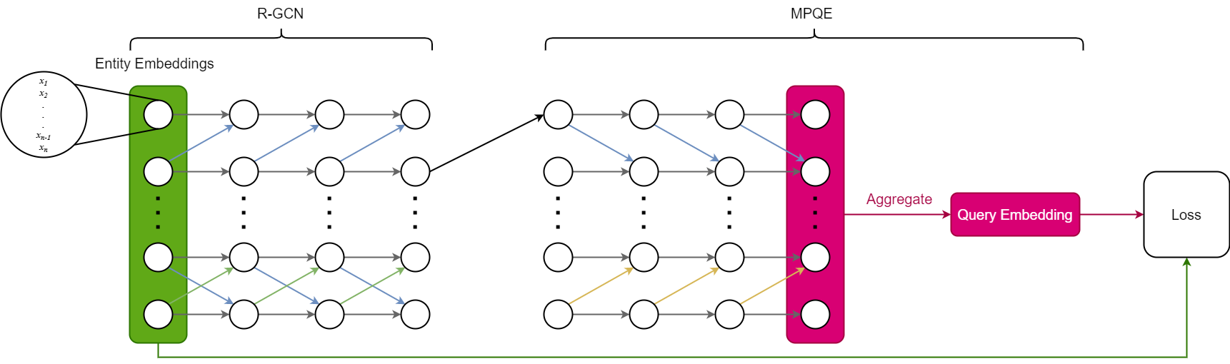
Full Network (Training Mode)

Slide 15
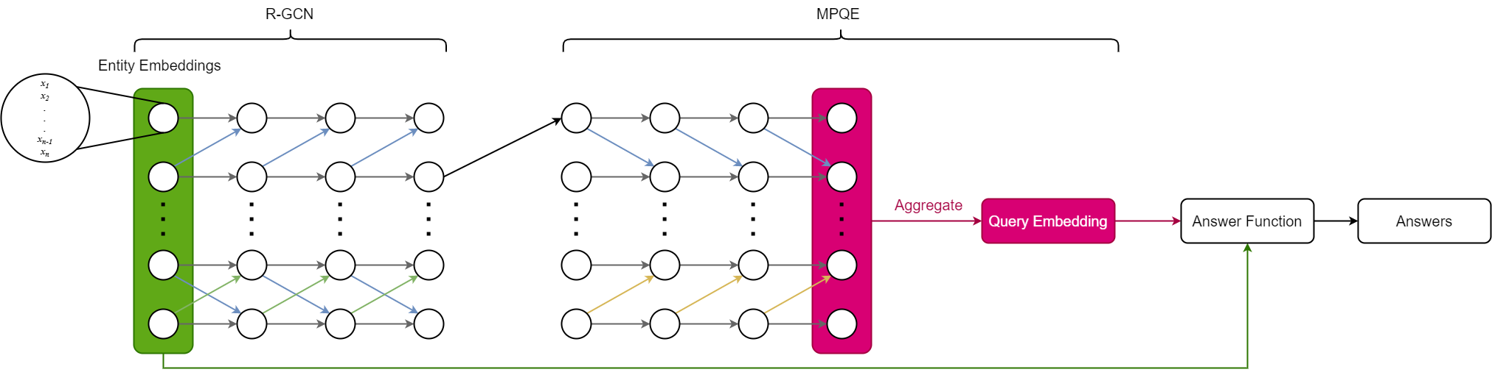
Full Network (Answering Mode)

Slide 16
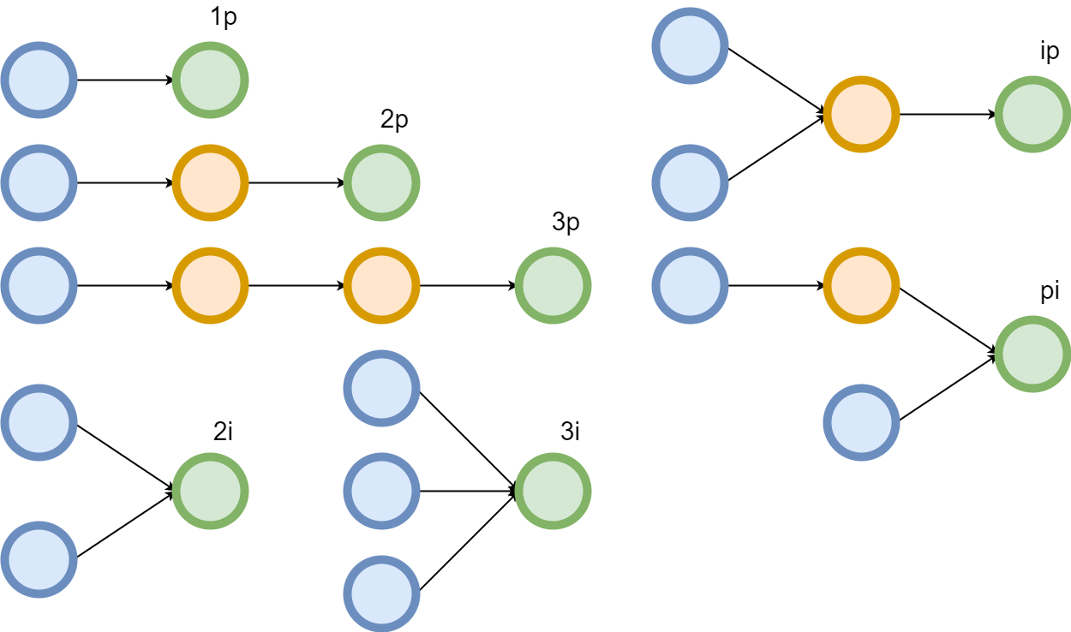
Query Structures

Slide 17
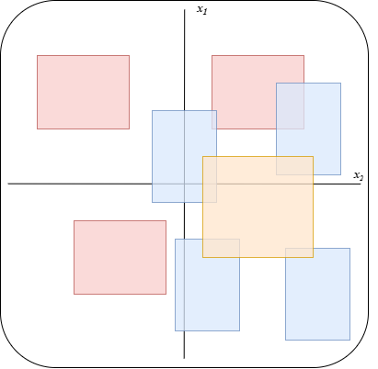
When is an entity considered an answer?
Some overlap is enough

Slide 18
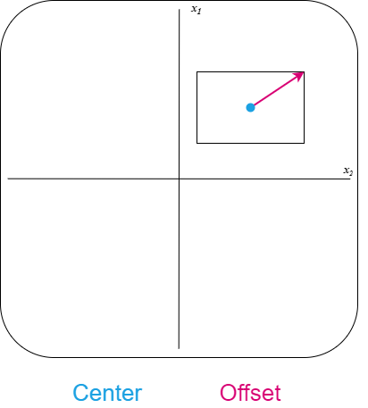
Entity embeddings
Represent boxes using two vectors
Uniform and Normal Distribution

Slide 19
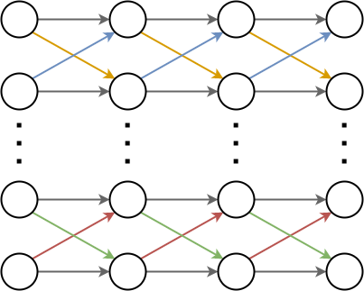
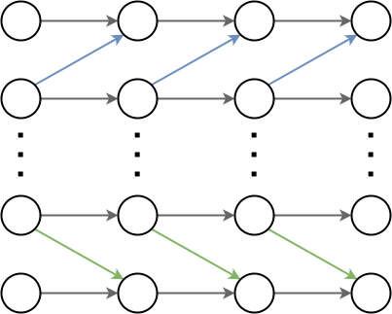
R-GCN
1
Message Passing
Neighbourhood
Reverse Edges
Anchor Nodes
[1] Schlichtkrull, M., Kipf, T. N., Bloem, P., van den Berg, R.,Titov, I., and Welling, M. (2017). Modeling relational data with graph convolutional networks

Slide 20
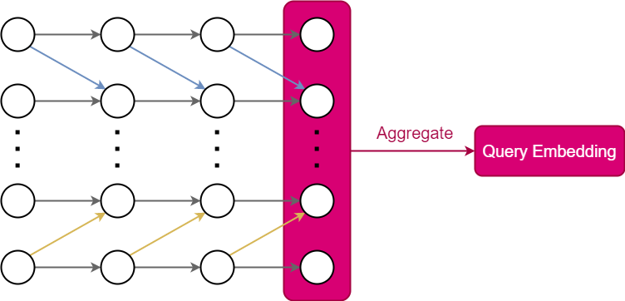
MPQE
1
Anchor Embeddings
Generic Type Embeddings
[1] Daza, D. and Cochez, M. (2020). Message passing query embedding. In ICML Workshop - Graph Representation Learning and Beyond

Slide 21
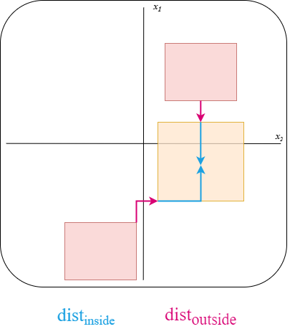
Distance Metric
1
[1] Inspired by: Ren, H., Hu, W., and Leskovec, J. (2020). Query2box: Reasoning over knowledge graphs in vector space using box embeddings

Slide 22
Loss
1
[1] Inspired by: Ren, H., Hu, W., and Leskovec, J. (2020). Query2box: Reasoning over knowledge graphs in vector space using box embeddings

Slide 23
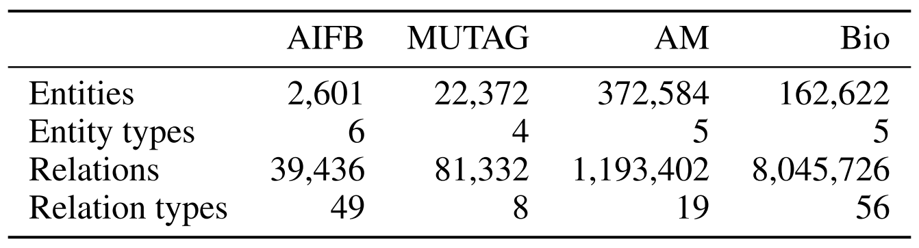
The Datasets
1
[1] From: Daza, D. and Cochez, M. (2020). Message passing query embedding. In ICML Workshop - Graph Representation Learning and Beyond

Slide 24
Training
Remove Graph Edges
Generate Query Graphs
Find Positive Answers
Remove Query Graph Edges
Find Negative Answers

Slide 25
Validation
Keep all query graph edges

Slide 26
Testing
Keep all edges

Slide 27
Results
None as of yet
Binary Classification Metrics

Slide 28
Future Experiments and Other Research
Different loss
Different ways of sampling
With or without types
Train only on 1-chain queries
Further exploration of the hyperparameters (hyperparameter optimization)

Slide 29
The End
Ruud van Bakel
r.van.bakel@student.vu.nl

